Slide 1
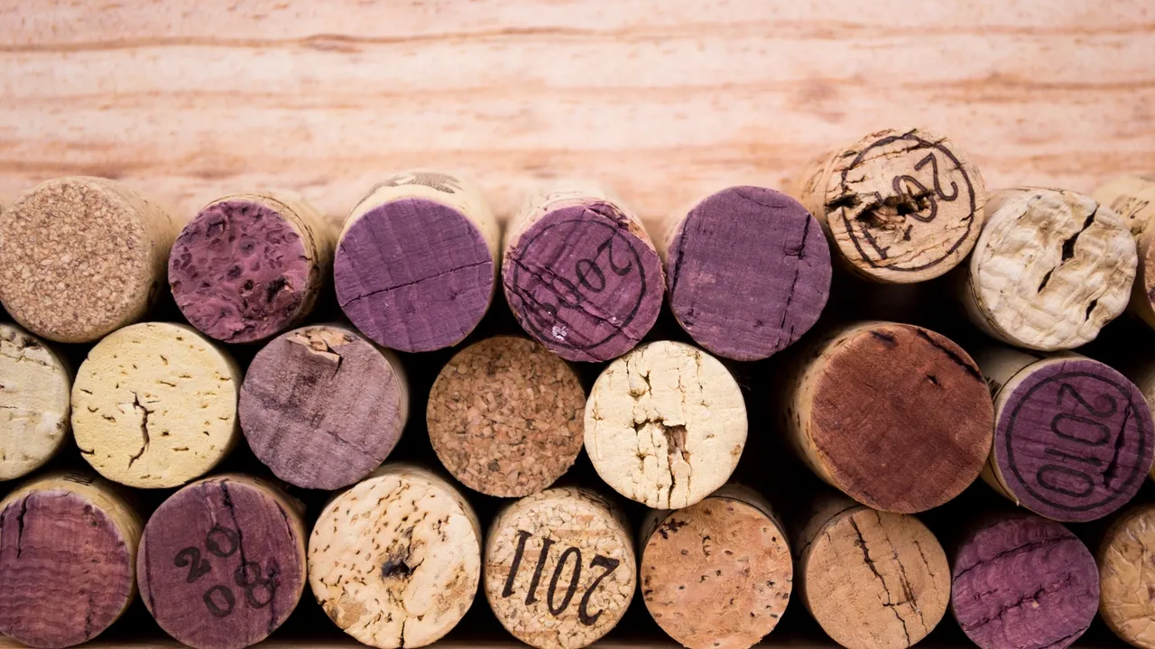
Wine Analysis

Slide 2
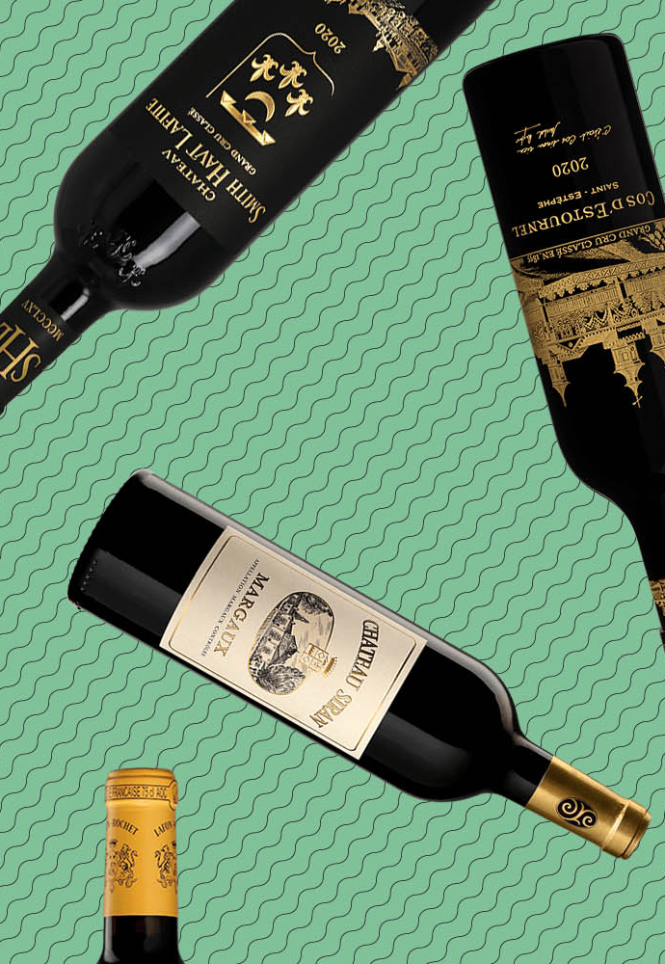
Project 4 Team 2
Kimberly Childers
Fernanda Valdez
Misha Borunda

Slide 3

PROJECT SUMMARY
This project utilizes three different data sets to do a comprehensive analysis about wine.
Two of the chosen datasets will be used for Machine Learning to train a model and make predictions about Red and White Wines based on their physicochemical composition.
In addition to the Machine Learning portion of the project, there will be an analysis and visualization done on Tableau to portray insights from the datasets and create an interactive way for users to learn about wine types and quality and the variables that affect it.
At the end of the project, there will be a Full Stack Web Application combining our ML Research, BI dashboards, and Reports about Wine, its quality and other characteristics.

Slide 4
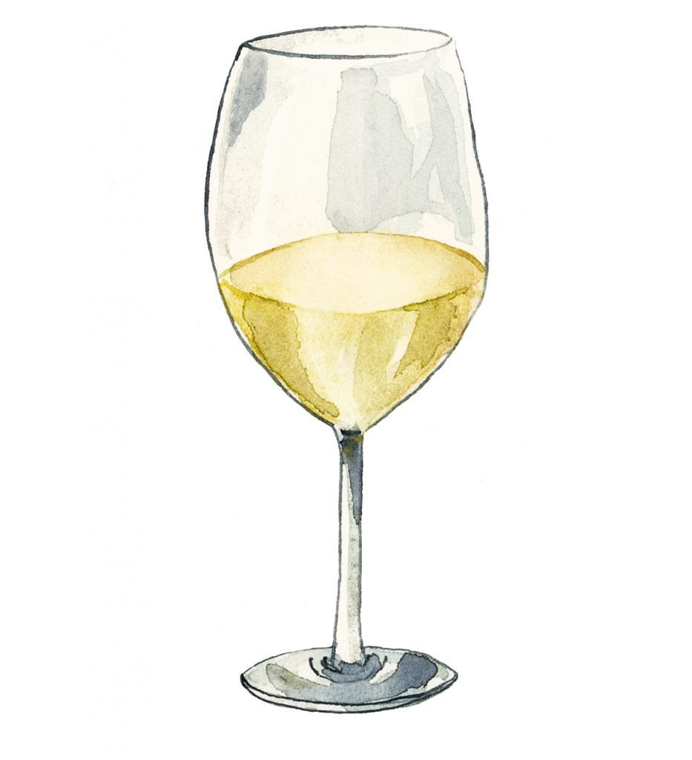
Data sets
Wine Quality Data Sets
One data set if for Red Wine only and the other one is for White Wine only
Both Datasets include the same physicochemical variables
https://www.kaggle.com/datasets/uciml/red-wine-quality-cortez-et-al-2009?resource=download
https://www.kaggle.com/datasets/piyushagni5/white-wine-quality
Wine Reviews Data Set
includes Wine regions, points and prices
https://www.kaggle.com/datasets/zynicide/wine-reviews

Slide 5

DatA CLEANING
Two data sets were merged for the ML portion of the analysis to be able to create a model to predict wine types (Red vs White) based on physical and chemical characteristics
There were no Null-Values, therefore rows of data did not need to be dropped
A new column “wine_type” was created to identify wine types in the combined data frame
One-Hot encoding was used to classify red wines as “1” and white wines as “0”

Slide 6

MACHINE LEARNING
ML Models were created to predict Red vs White Wine based on the Physical and Chemical Characteristics.
These Characteristics include:
Fixed Acidity
is the set of the wine’s natural acids
preserve the wine’s natural qualities, as well as its color.
Volatile Acidity
is a measure of a wine’s gaseous acids.
The amount of VA in wine is often considered an indicator of spoilage
Citric Acid
It can be added to finished wines to increase acidity and give a “fresh” flavortive or additive to food or drink to add a sour taste to food
Residual Sugar
is from natural grape sugars leftover in a wine after the alcoholic fermentation finishes
Chlorides
depends on the geographic, geologic and climatic conditions of vine culture
the content is increased in wines coming from vineyards which are near the sea coas
Free Sulfur Dioxide
Density
Mass/Volume – How heavy the wine is
PH
Influences the taste of the final product, but also its colour, oxidation and chemical stability.
Alcohol

Slide 7
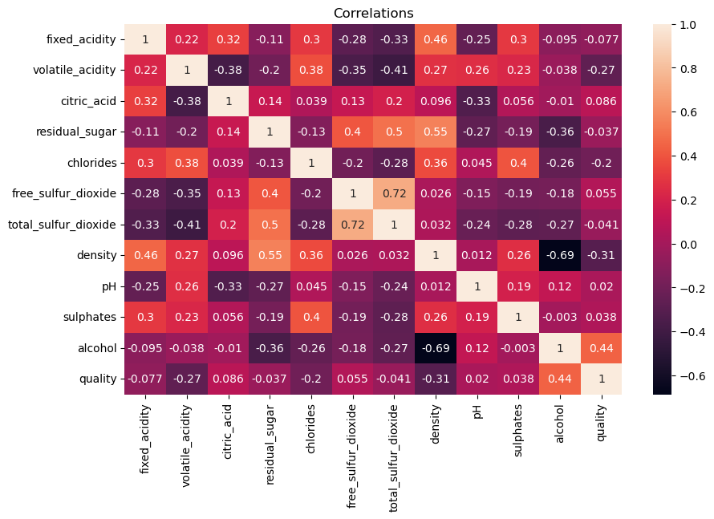
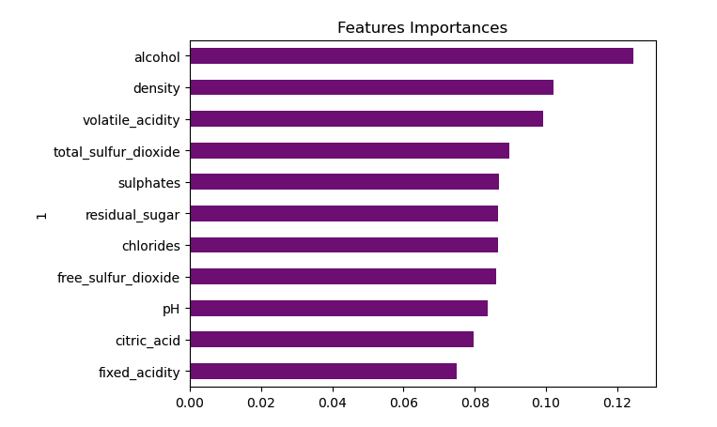
Original Approach
To predict Wine Quality based on the physical and chemical properties
Alcohol, Density and Volatile Acidity were the only features that presented a “Moderate” Correlation
Since there were no strong correlations we decided to change our model to predict wine type (Rev vs White) instead

Slide 8
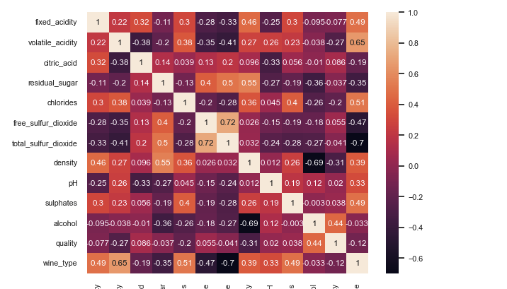
Actual ML model
Predicts wine type (Red vs White) based of physical and chemical properties
Out of 11 of the features taken into account, 9 of them had moderate to strong correlations with wine type.
The strongest correlations being: total Sulfur Dioxide, Volatile Acidity and Sulfates

Slide 9
FINDINGS

Slide 10
Links
https://agrovin.com/en/techniques-for-correcting-wine-acidity/#:~:text=Fixed%20acidity%20is%20the%20set,of%20tartaric%20acid%20per%20litre.
https://www.wineenthusiast.com/basics/drinks-terms-defined/volatile-acidity-wine/
https://wineserver.ucdavis.edu/industry-info/enology/methods-and-techniques/common-chemical-reagents/citric-acid
https://winefolly.com/deep-dive/what-is-residual-sugar-in-wine/
https://wineamerica.org/the-magic-of-wine/wine-facts/

